Slide 1



@torokagoston agostontorok.github.io @tony_does_science

Slide 2
hello.
Notes:
Hello everyone. Let me start this talk in a little peculiar way, namely with an anouncement. Today, we are introducing the new phone 8

Slide 3
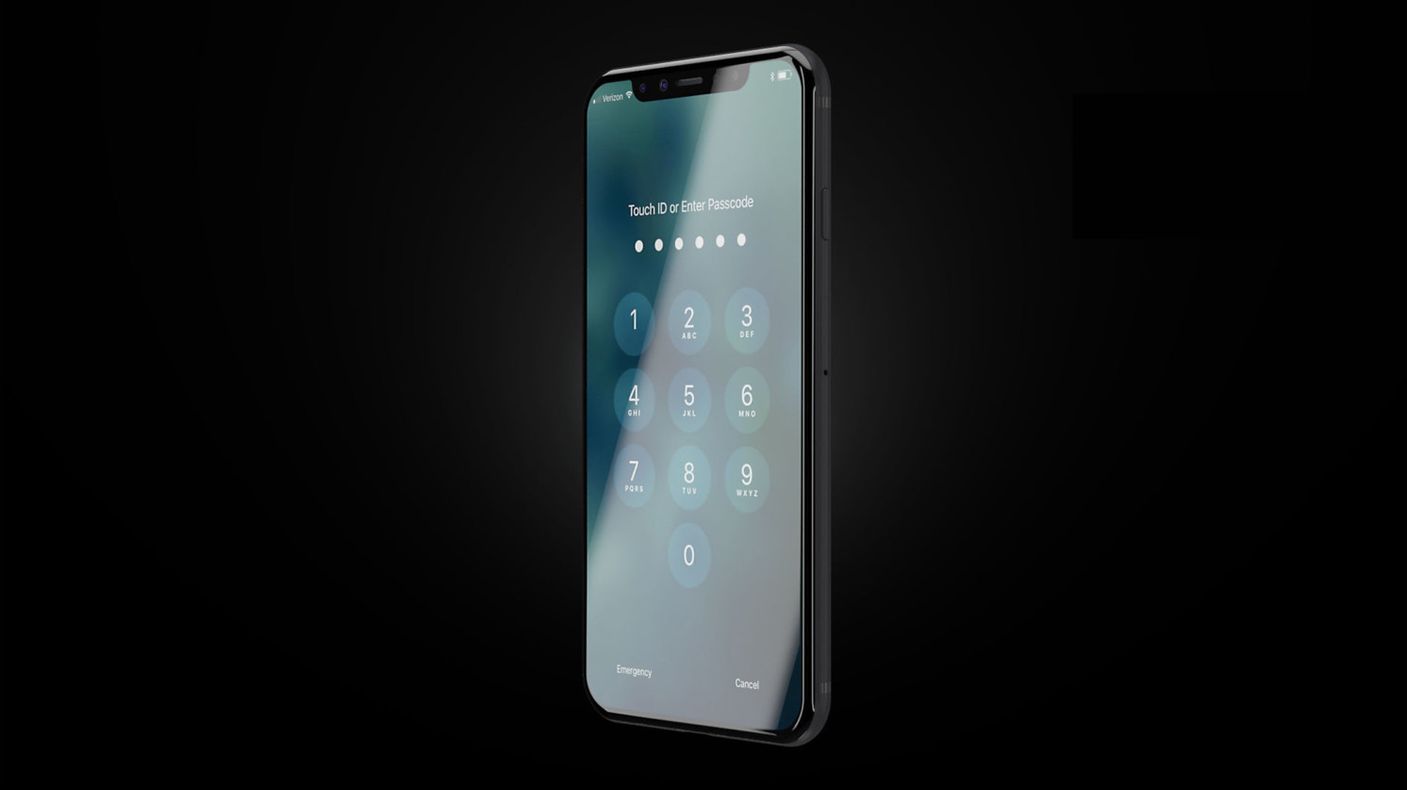
Phone 8
Better camera
Better features
Longer battery life
Larger screen
Notes:
This is a breakthrough product, it has better camera, better features, longer battery life and a larger screen. From these key changes I would like to talk about probably the most important one, the screen

Slide 4
Phone 8
Better camera
Better features
Longer battery life
Larger screen
Notes:
This is my phone, it has a 5 inch display and I often feel it small: My typing speed is XX on this phone, this is faster than the average which is XX worldwide. However, I feel less productive compared to my desktop, where I can easily reach XX keys per minute. Considering that I have
https://www.google.hu/search?safe=off&biw=1422&bih=655&tbm=isch&sa=1&q=phone+in+pocket&oq=phone+in+pocket&gs_l=psy-ab.3..0i19k1l3j0i7i30i19k1.3551.5000.0.5321.5.4.1.0.0.0.94.310.4.4.0....0...1.1.64.psy-ab..0.5.315.cbP1kyb1E3o

Slide 5
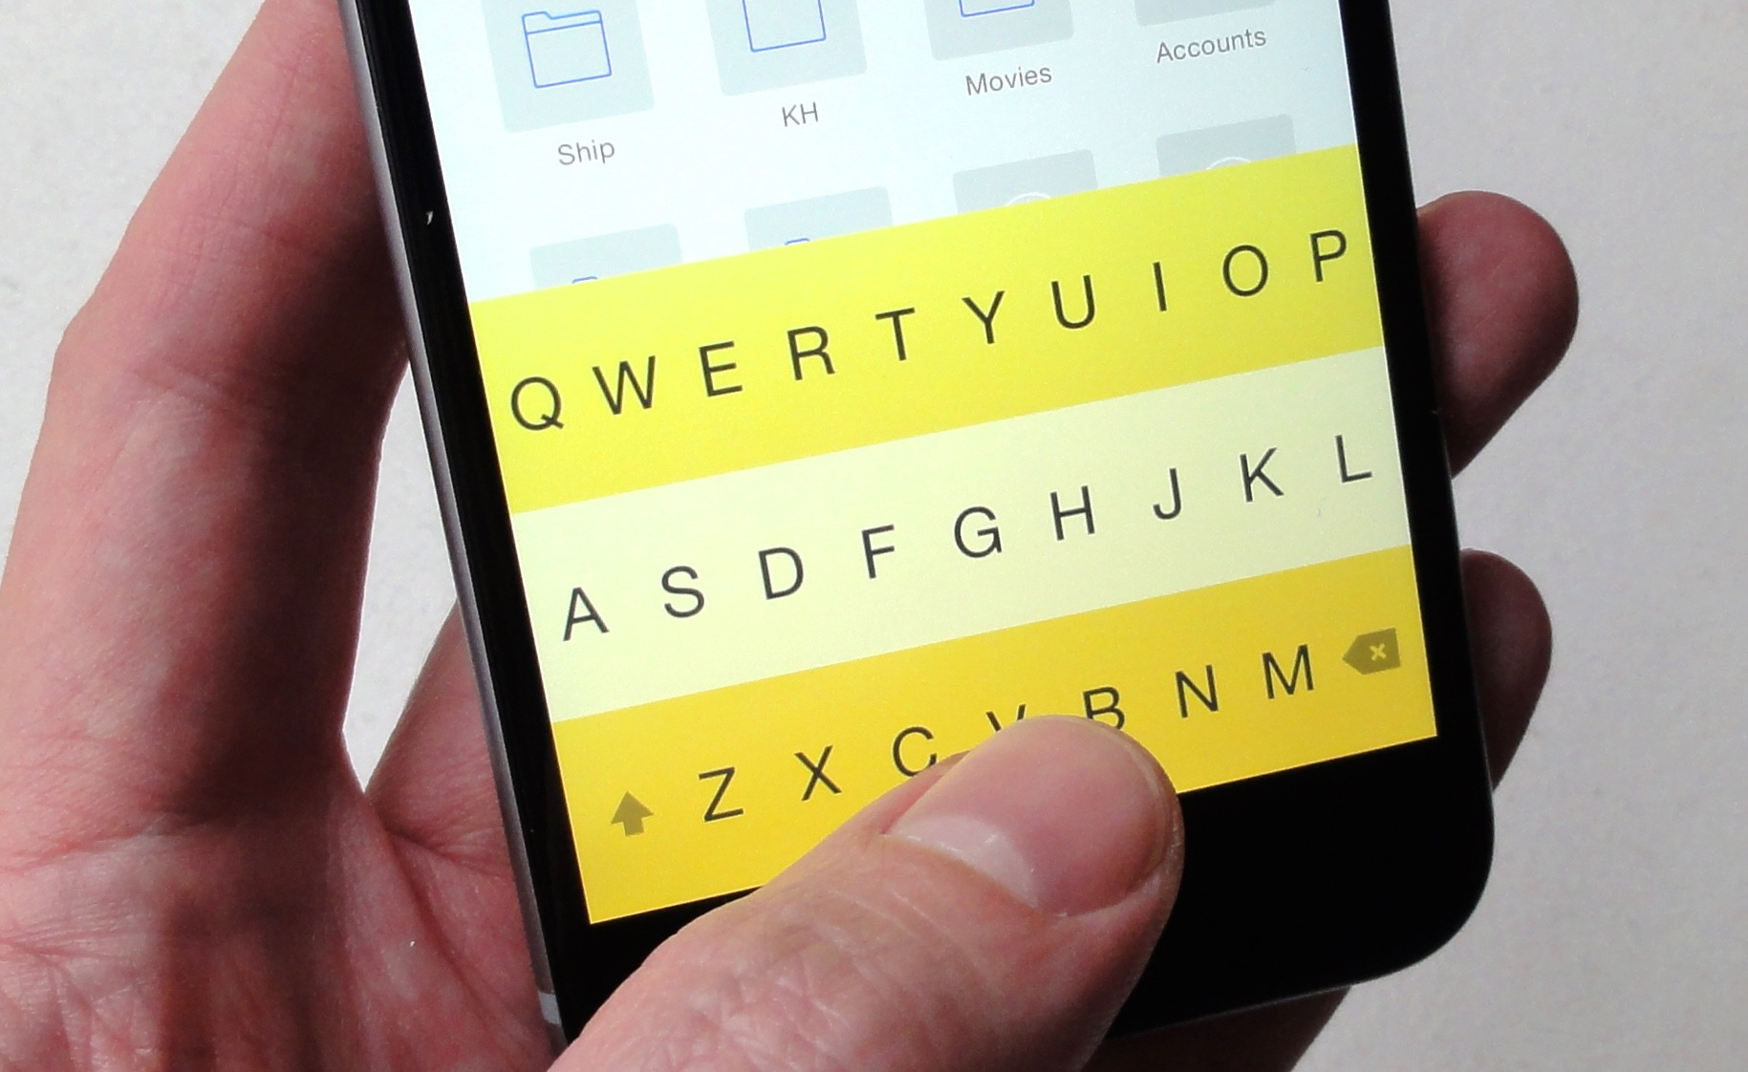

Slide 6
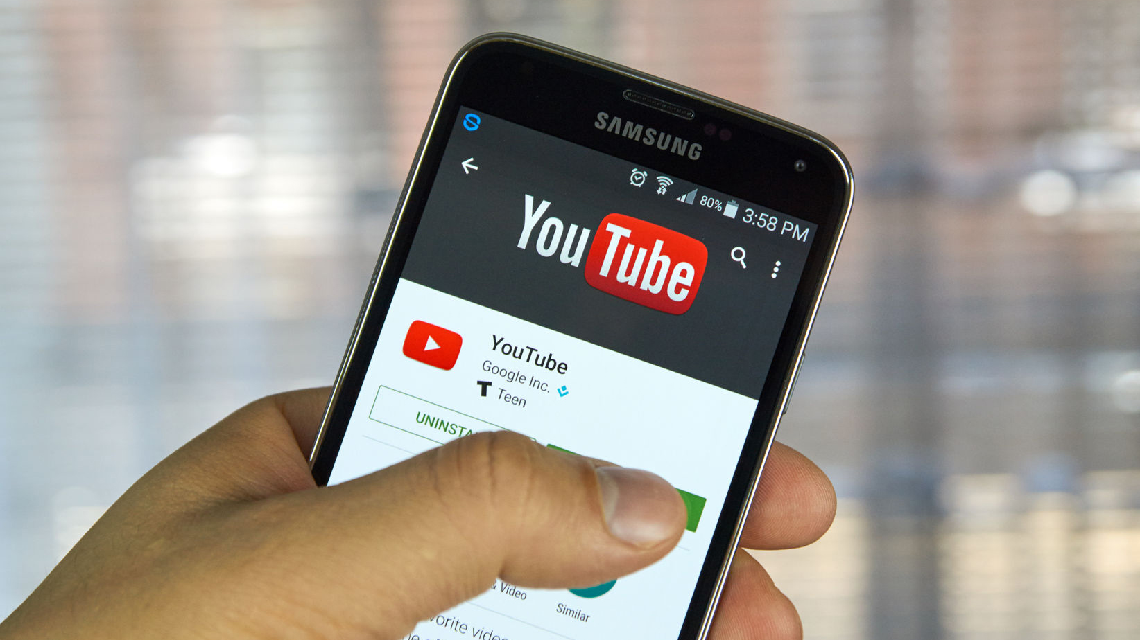

Slide 7
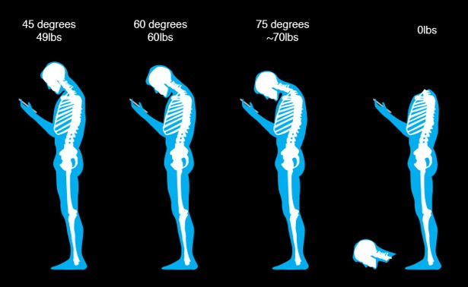

Slide 8
The neuroscience of virtual reality​
Notes:
I’ve always considered myself more of an applied scientist, interested in problems that would make people’s life easier, better and happier

Slide 9
VR is ..

Slide 10
VR is a tech challenge
Notes:
Needs to be cheaper Needs content Needs to be mobile - miniaturization
5g Speed
Prepared society (security)
•Consumers don’t really care about how difficult was the problem that you solved

Slide 11

VR is a tech challenge
Just let me play Angry Birds on my Oculus!
Notes:
Needs to be cheaper Needs content Needs to be mobile - miniaturization
5g Speed
Prepared society (security)
•Consumers don’t really care about how difficult was the problem that you solved

Slide 12
VR is ..

Slide 13
VR is the key to everything
Notes:
VR pizza ordering
Needs content Needs to be mobile - miniaturization
5g Speed
Prepared society (security)
•Consumers don’t really care about how difficult was the problem that you solved

Slide 14
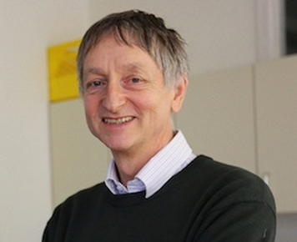
VR is the key to everything
Of course not, deep learning is!
Notes:
Needs to be cheaper Needs content Needs to be mobile - miniaturization
5g Speed
Prepared society (security)
•Consumers don’t really care about how difficult was the problem that you solved

Slide 15
VR is ..

Slide 16
VR is sg. I should invest in
Notes:
Needs to be cheaper Needs content Needs to be mobile - miniaturization
5g Speed
Prepared society (security)
•Consumers don’t really care about how difficult was the problem that you solved

Slide 17
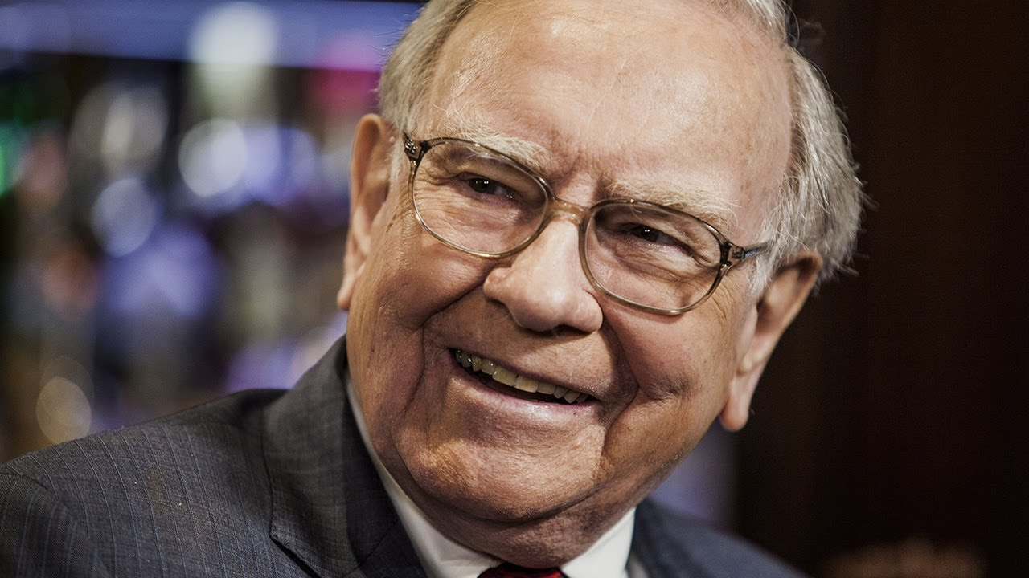
VR is sg. I should invest in
So you’ve got a hot tip for me?
Notes:
Needs to be cheaper Needs content Needs to be mobile - miniaturization
5g Speed
Prepared society (security)
•Consumers don’t really care about how difficult was the problem that you solved

Slide 18
VR is ..

Slide 19
VR is the new interface.
Notes:
Needs to be cheaper Needs content Needs to be mobile - miniaturization
5g Speed
Prepared society (security)
•Consumers don’t really care about how difficult was the problem that you solved

Slide 20
Intuitive
Notes:
Needs to be cheaper Needs content Needs to be mobile - miniaturization
5g Speed
Prepared society (security)
•Consumers don’t really care about how difficult was the problem that you solved

Slide 21
Intuitive
Organic
Notes:
Needs to be cheaper Needs content Needs to be mobile - miniaturization
5g Speed
Prepared society (security)
•Consumers don’t really care about how difficult was the problem that you solved

Slide 22
Intuitive
Organic
Unconstrained
Notes:
Needs to be cheaper Needs content Needs to be mobile - miniaturization
5g Speed
Prepared society (security)
•Consumers don’t really care about how difficult was the problem that you solved

Slide 23

in·tu·i·tive ​
intuitive​
\in-ˈtü-ə-tiv, -ˈtyü-\​
adjective
known or perceived by intuition : directly apprehended
readily learned or understood

Slide 24
Look at oculus

Slide 25
and woman

Slide 26
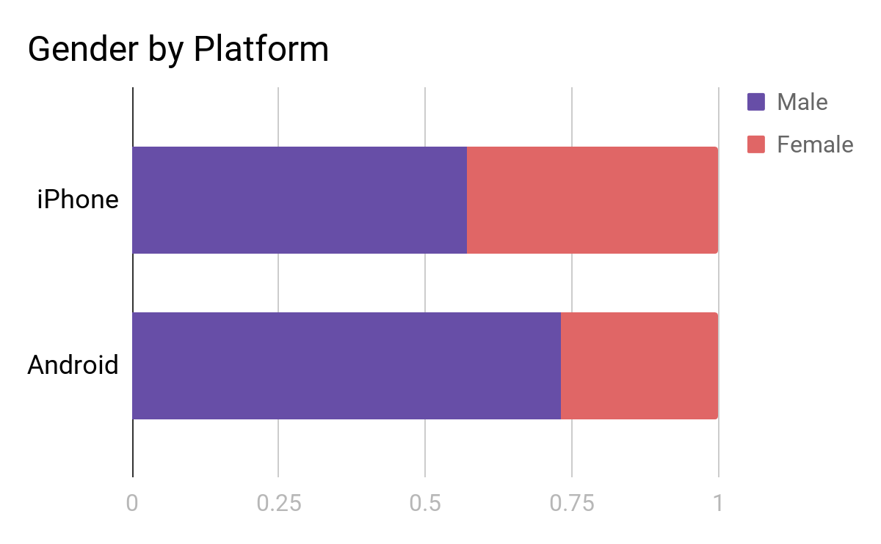
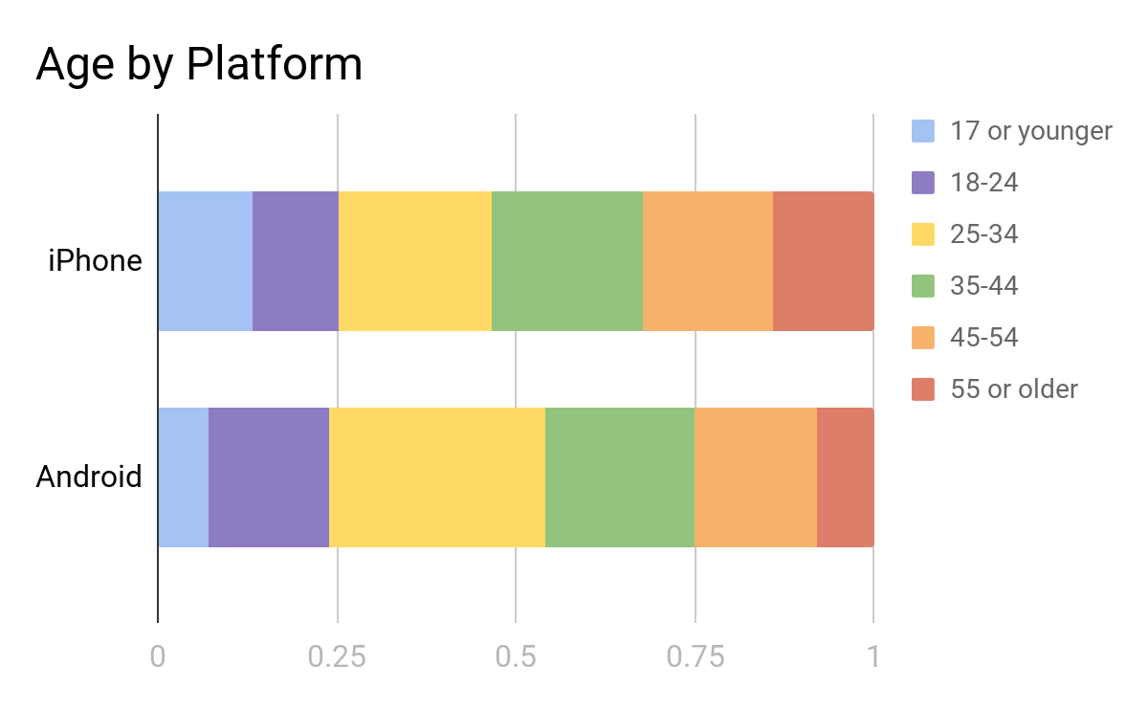
Early adopters
source admob

Slide 27
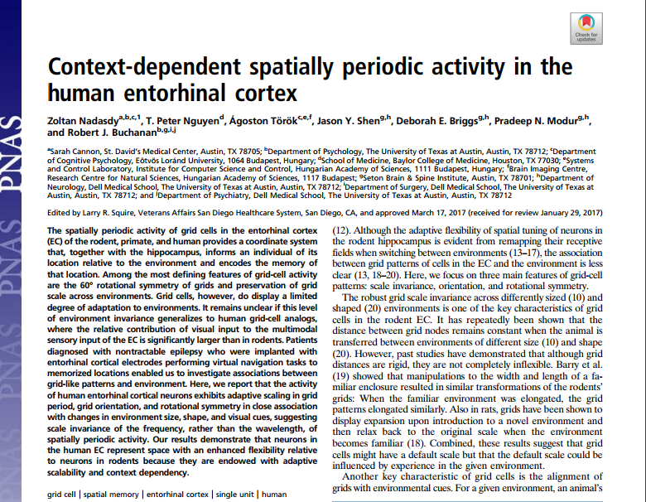
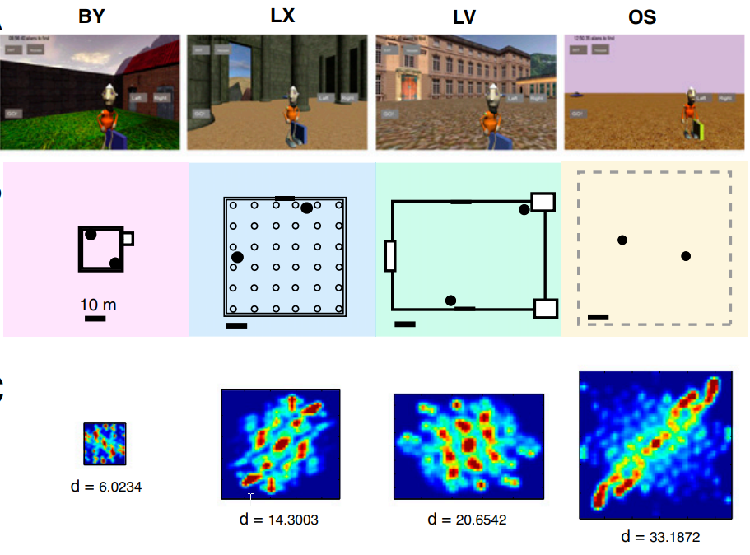
Grid cells adapt to environment size in humans
Notes:
Online pdf

Slide 28
and woman

Slide 29
show the other players

Slide 30
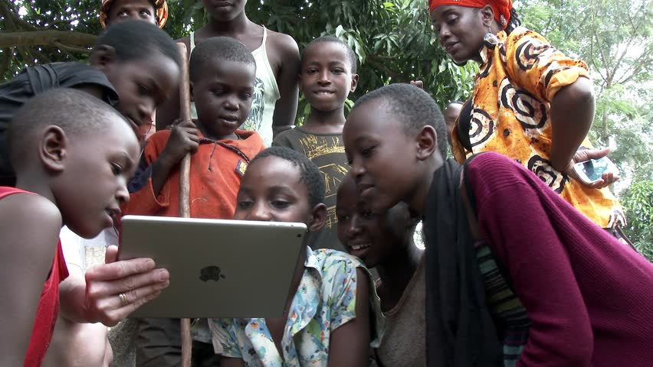
Notes:
Show the game
Picture of me showing the game to my grandma
Family - developmental aspects
The question of interaction
You should never spend time on inventing the wheel
What should you show

Slide 31
“...think about lifting your right arm if you want to move forward…”

Slide 32
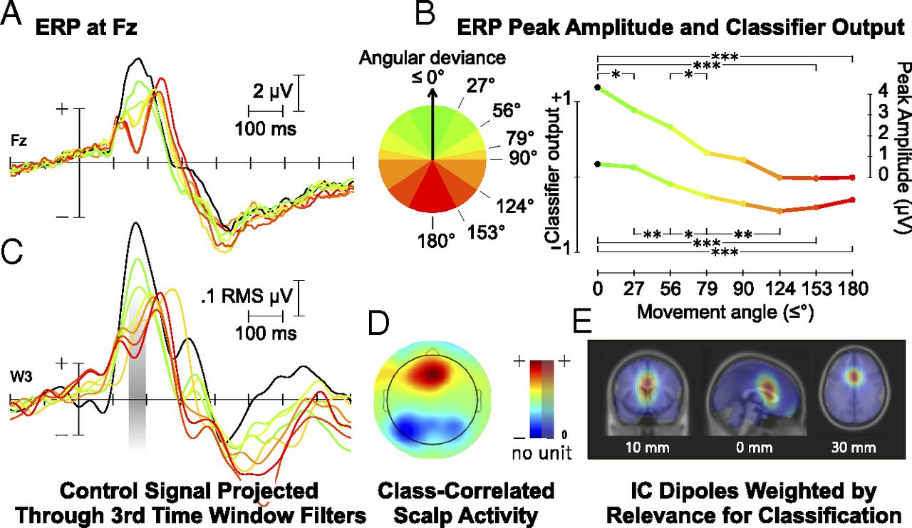
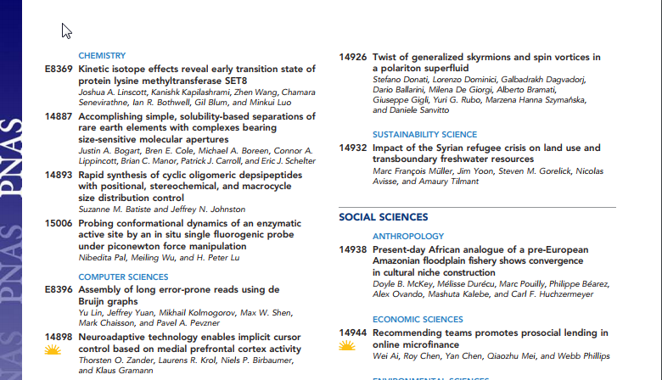
Zander et al. PNAS 2016
Notes:
Online pdf

Slide 33
focus on finding the wheel
instead of reinventing it

Slide 34
or·gan·ic ​
organic​
\ȯr-ˈga-nik\​
adjective
relating to, or arising in a bodily organ
relating to, or derived from living organisms
forming an integral element of a whole

Slide 35

close your eyes, please

Slide 37
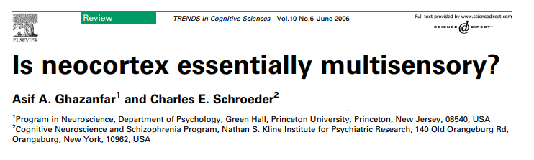
Notes:
Online pdf

Slide 38
so much ...
Notes:
That even what we believe is unisensory is actually multisensory

Slide 39
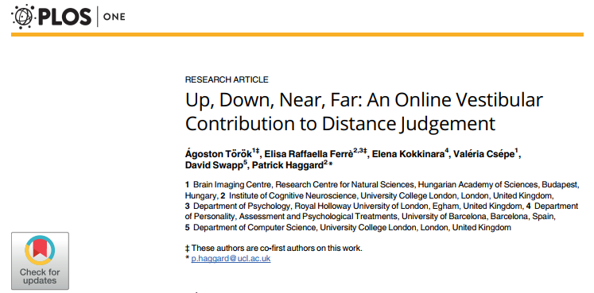
Notes:
Online pdf

Slide 40
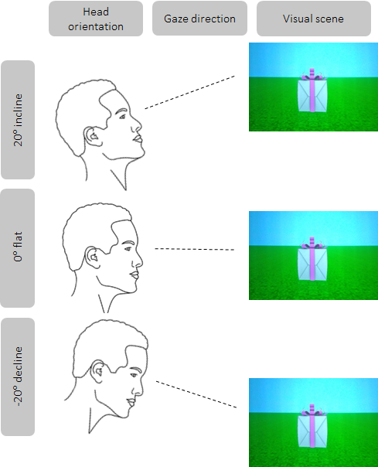
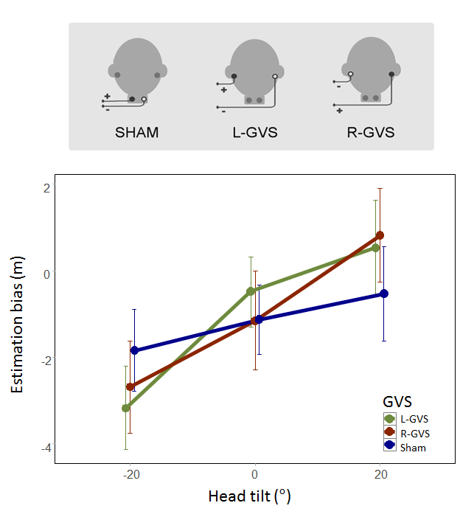

Slide 41
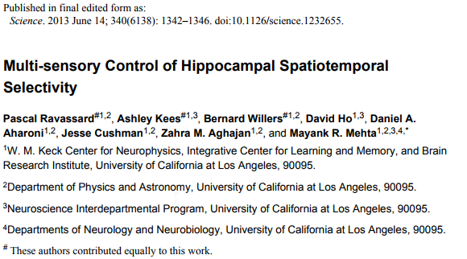

Slide 42
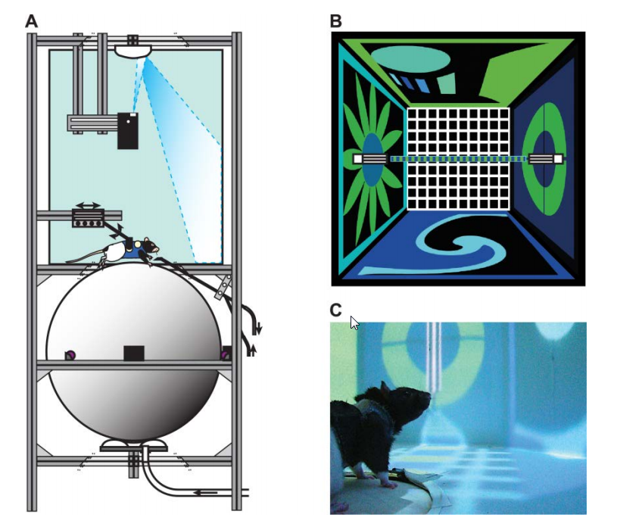

Slide 43
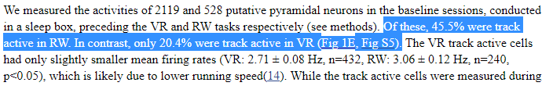

Slide 44
going fully virtual?

Slide 45
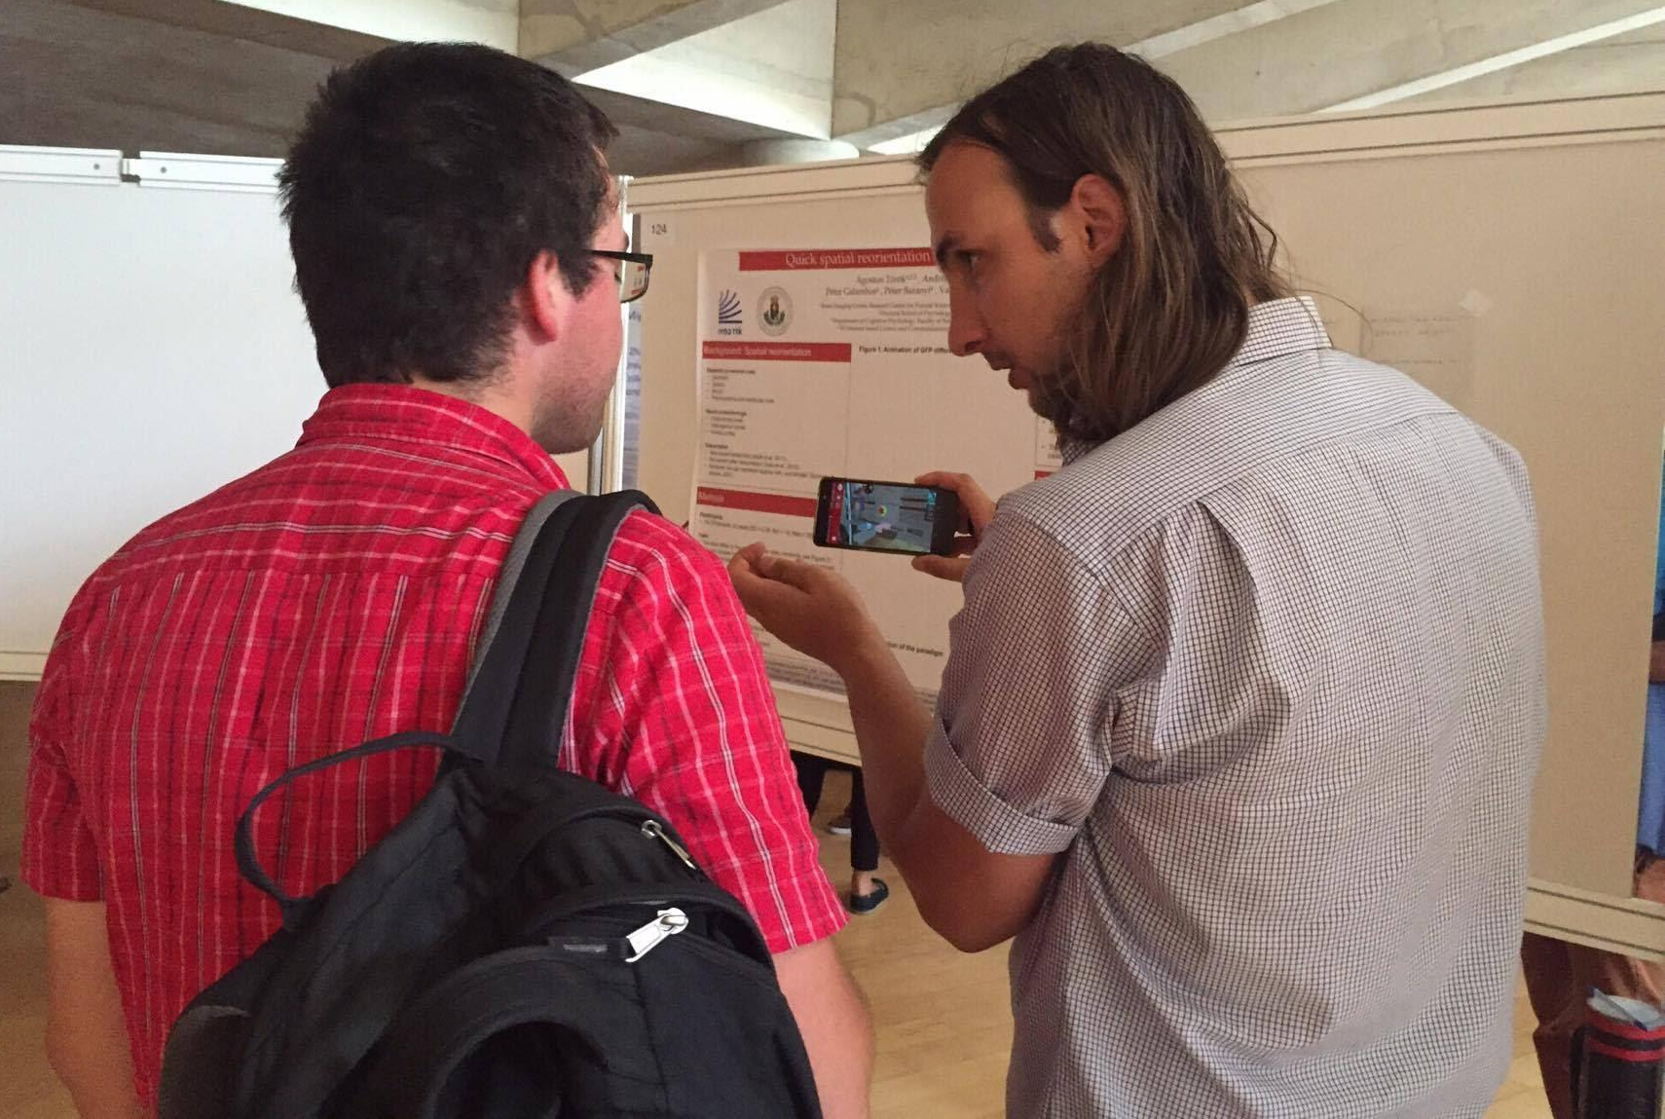
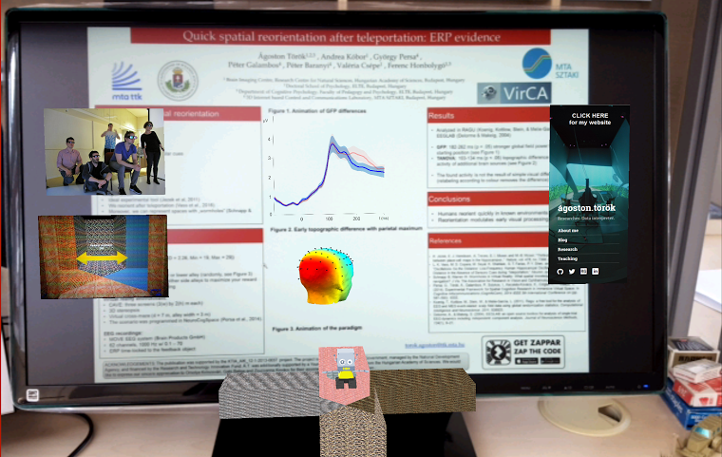
Notes:
Talk about Magic Leap

Slide 46
more than meets the eyes

Slide 47
un·con·strained ​
unconstrained​
\ˌən-kən-ˈstrānd\
adjective
not held back or constrained
not restricted or limited

Slide 48

Notes:
In order to create a radically new and better interface we have to think outside the box, and sometimes even forget that there was ever any box

Slide 49
old habits die hard.

Slide 50
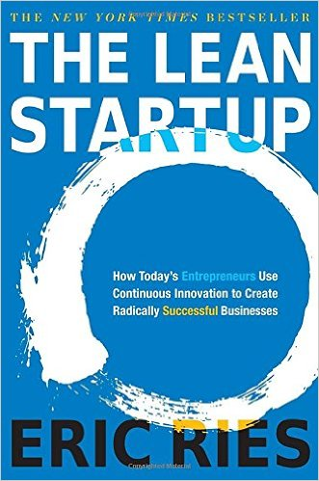

Slide 51



Slide 52
Start in south

Slide 53
Turn left

Slide 54
Teleport to North

Slide 55
Turn right

Slide 56
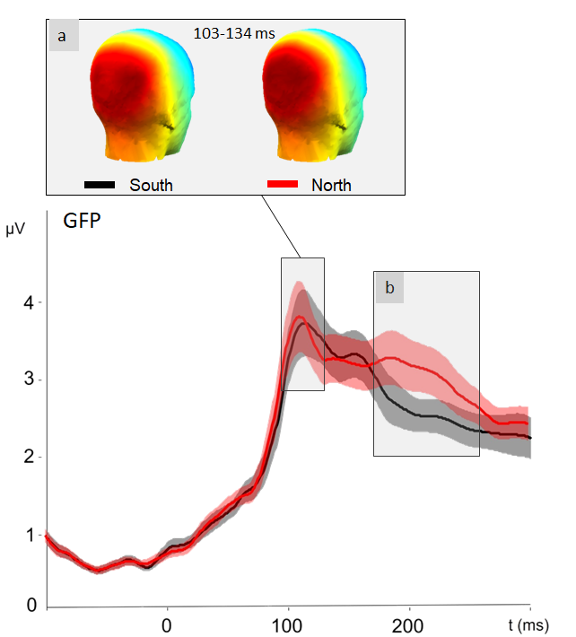
Notes:
Show the experiment

Slide 57
Think outside the box
Maybe forget if there
has ever been a box

Slide 58
conclusions.

